Slide 1
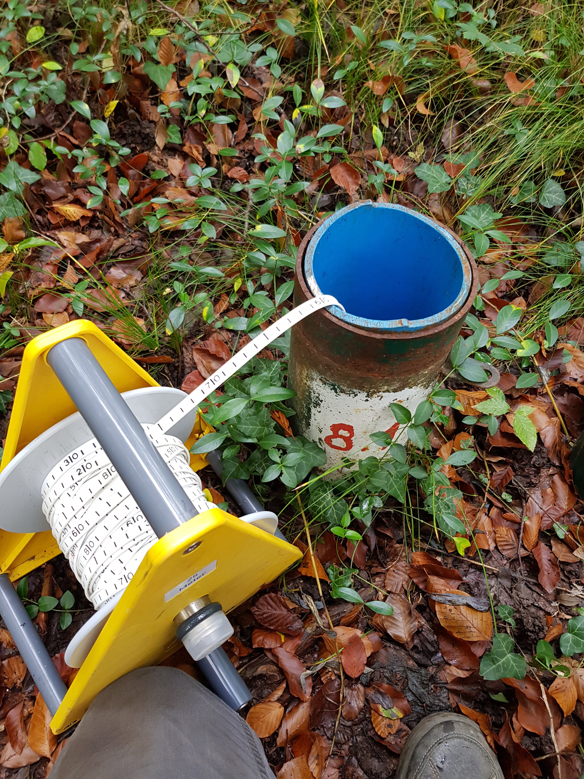
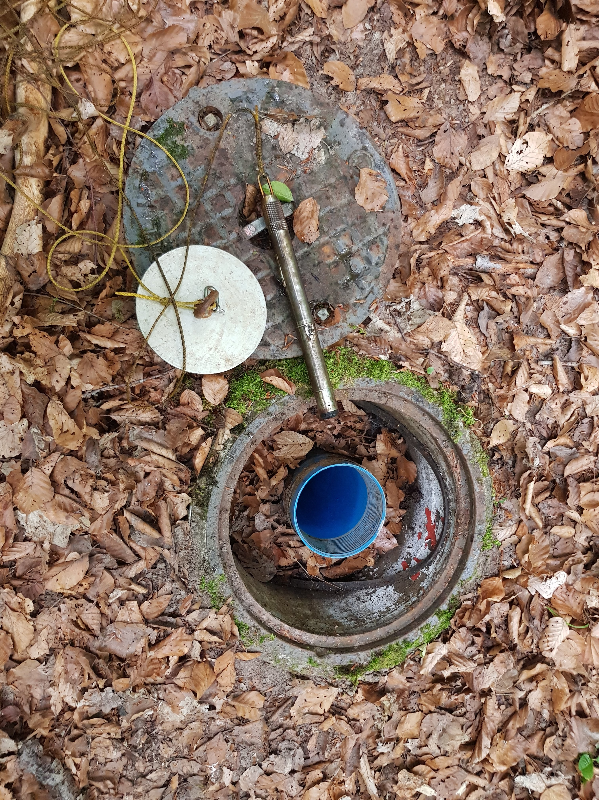
Shallow well
X.2
Deep well
X.1
Soil surface
Leveling
Distance to groundwater
Dipper
Measuring tape
Groundwater table
Diver

Slide 2
Soil surface
Leveling
Distance to groundwater
Dipper
Groundwater table
Diver

Slide 3
Shallow well
X.2
Deep well
X.1
Soil surface
Groundwater table
Sensor with data logger

